Slide 1

.crash course
Christina Protopapadaki, Filip Jorissen & Bram van der Heijde
Christina.Protopapadaki@kuleuven.be Filip.Jorissen@kuleuven.be,
Bram.vanderHeijde@kuleuven.be
October 20, 2017

Slide 2
Modelica crash course
What is Modelica ?
Syntax, language concepts and model structuring
Modelica tools
Use of IDEAS library
Getting started (tutorials, reference docs, libraries, software implementations, ...)
➔ To get you started with Modelica!

Slide 3
What is Modelica?

Slide 4

What is Modelica
Modelica is a language for modeling of physical systems
open source
object oriented
acausal modeling (equation based)
multi-domain
primarily for simulation, but usable for optimization
small and large models (> 100 000 equations)
many model libraries (free and commercial)
textual and graphical modeling

Slide 5
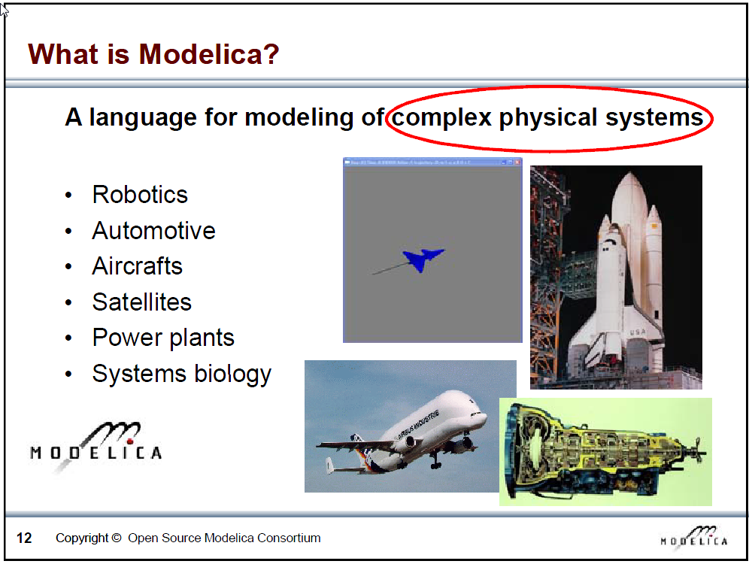
Slide from Peter Fritzson, Introduction to Object-Oriented Modeling, Simulation and Control with Modelica, Tutorial for Modelica Conference 2011, Dresden

Slide 6
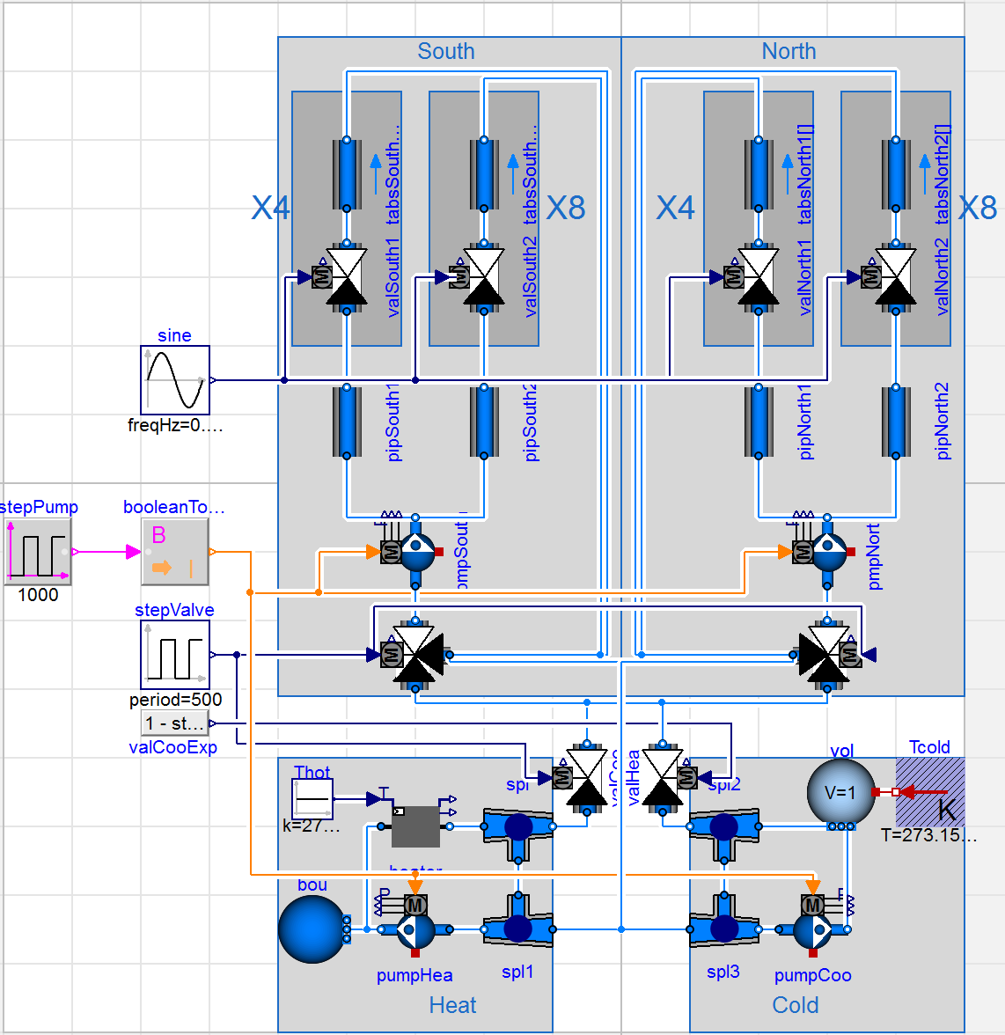
What is Modelica?
Modeling and simulation of complex physical systems
But optimization is possible
JModelica

Slide 7
What is Modelica?
Language, not a tool
Tools:
Dymola
OpenModelica
JModelica
Different tools
➔ Different GUI, workflow
➔ Possibly slightly different results
Check www.modelica.org for more information

Slide 8
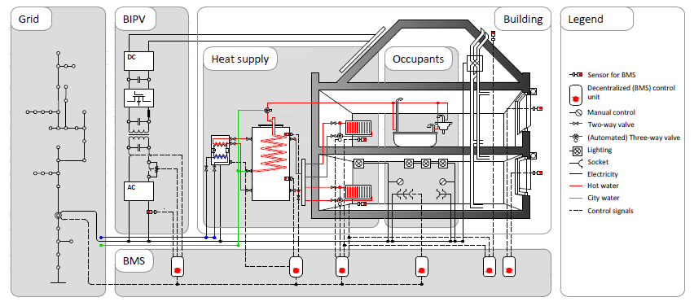
Multi-physics environment

Slide 9
Modelica vs. Simulink-style
Block Diagram Modeling Acausal Modeling
What does it mean to connect three ports?
Slide from Michael Wetter and Thierry Nouidui, Introduction to Modelica (2015), see http://simulationresearch.lbl.gov/modelica/downloads/workshops/2015-06-22-lbnl/slides/modelica-intro.pdf
Notes:
Slide Michael wetter

Slide 10
Modelica vs. Simulink-style
What if we want to change heat injection to here?
Slide from Michael Wetter and Thierry Nouidui, Introduction to Modelica (2015), see http://simulationresearch.lbl.gov/modelica/downloads/workshops/2015-06-22-lbnl/slides/modelica-intro.pdf
Notes:
Slide Michael wetter

Slide 11
Modelica vs. Simulink-style
Slide from Michael Wetter and Thierry Nouidui, Introduction to Modelica (2015), see http://simulationresearch.lbl.gov/modelica/downloads/workshops/2015-06-22-lbnl/slides/modelica-intro.pdf
Notes:
Slide Michael wetter

Slide 12
How does Dymola work?

Slide 13
Modelica environments
Commercial software tool
Dymola (Dassault Systèmes, Sweden)
Free and open source tools
OpenModelica (Open Source Modelica Consortium, Sweden and other countries)
JModelica (Modelon, Sweden)

Slide 14
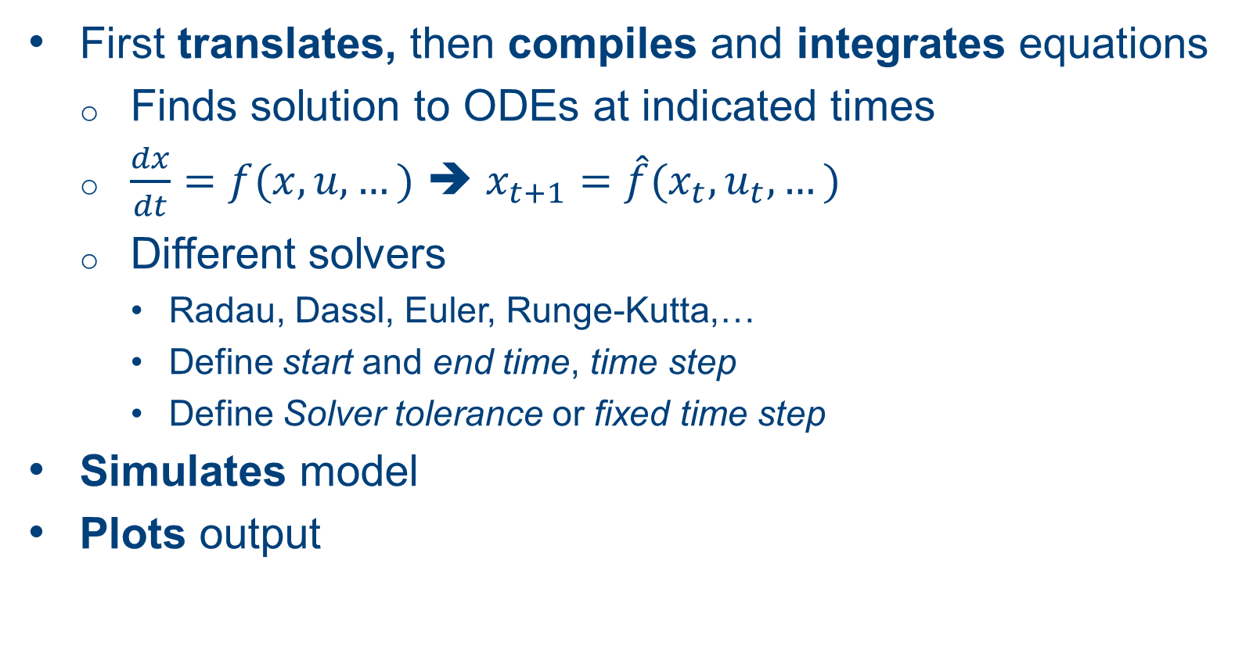
What does Dymola do?
First translates, then compiles and integrates equations
Finds solution to ODEs at indicated times
$\frac{dx}{dt}=f(x,u,…)$ ➔ $x_{t+1}=\hat{f}(x_{t},u_{t},…)$
Different solvers
Radau, Dassl, Euler, Runge-Kutta,…
Define start and end time, time step
Define Solver tolerance or fixed time step
Simulates model
Plots output

Slide 15
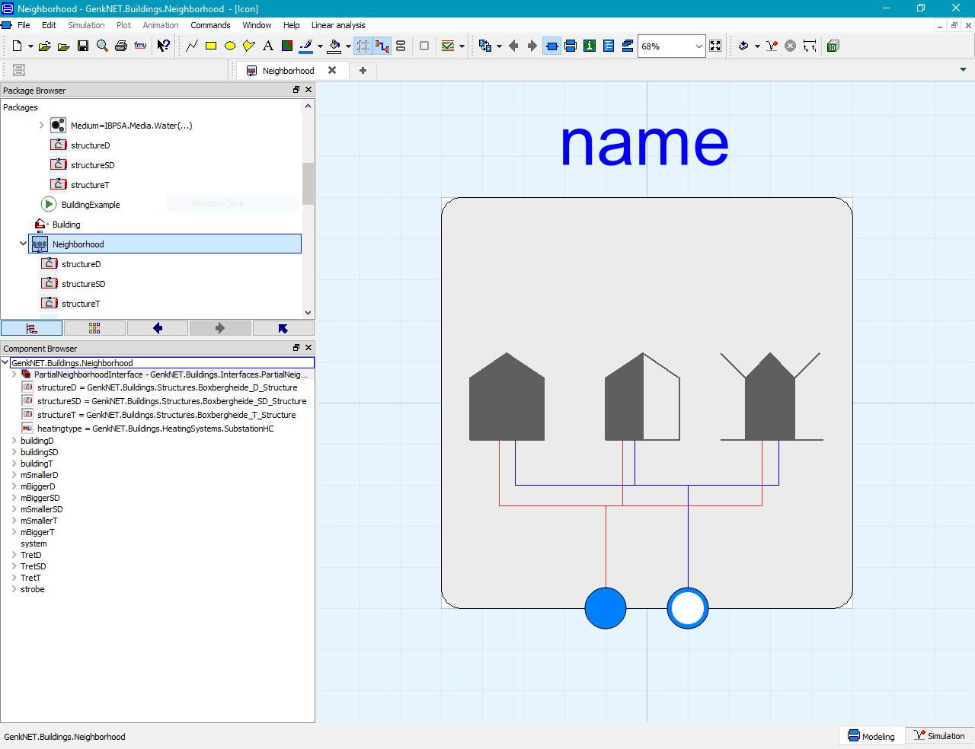
Graphical user interface
Icon view

Slide 16
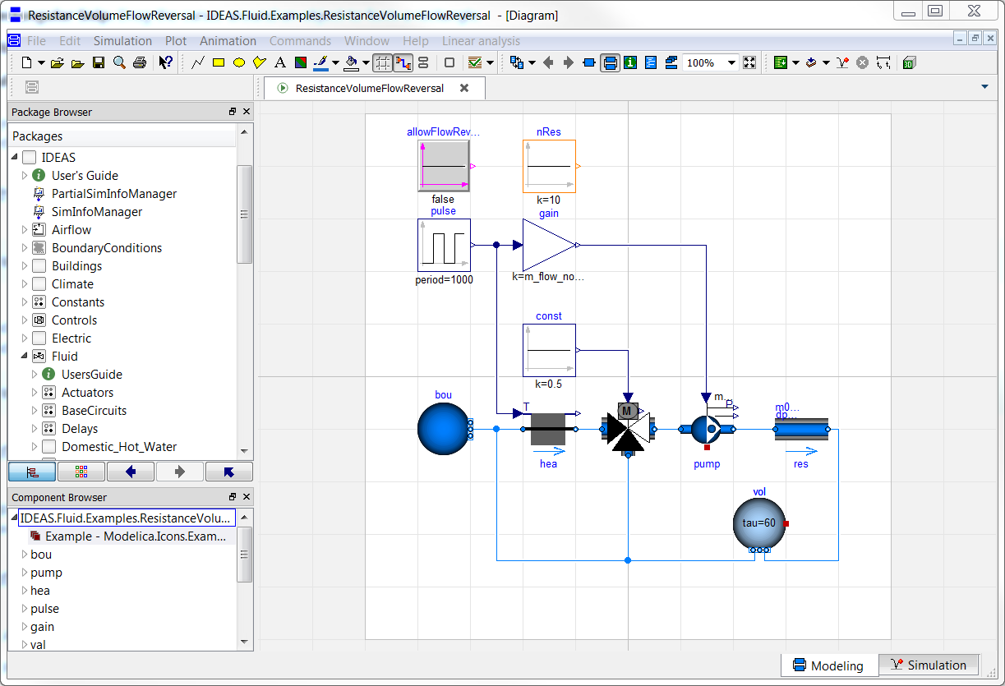
Graphical user interface
Diagram view

Slide 17
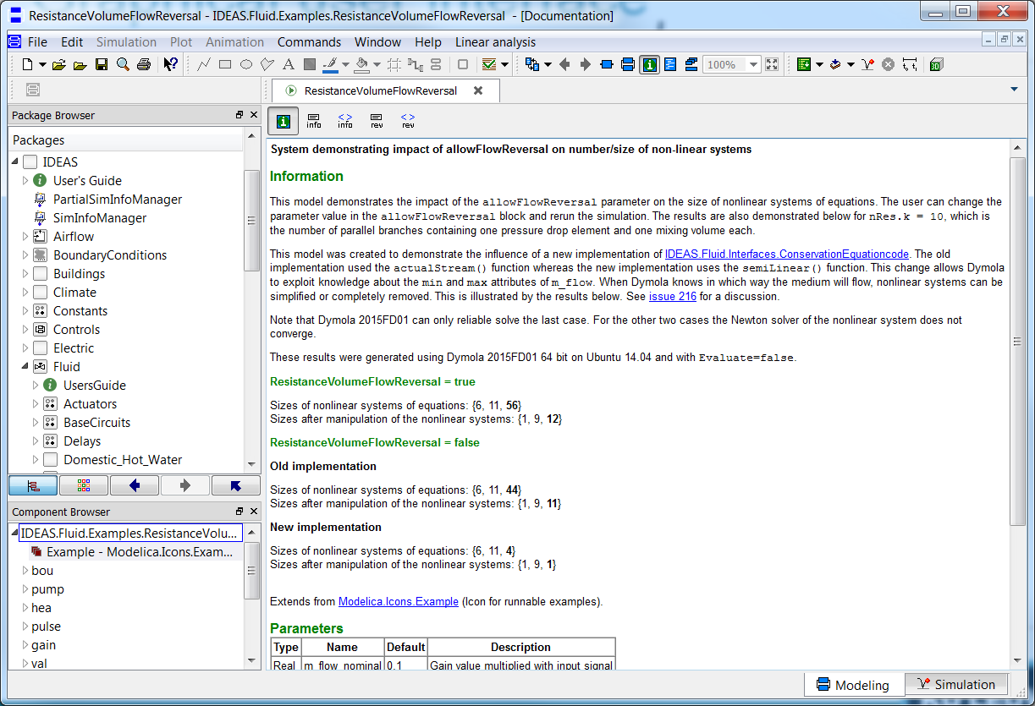
Graphical user interface
Documentation view

Slide 18
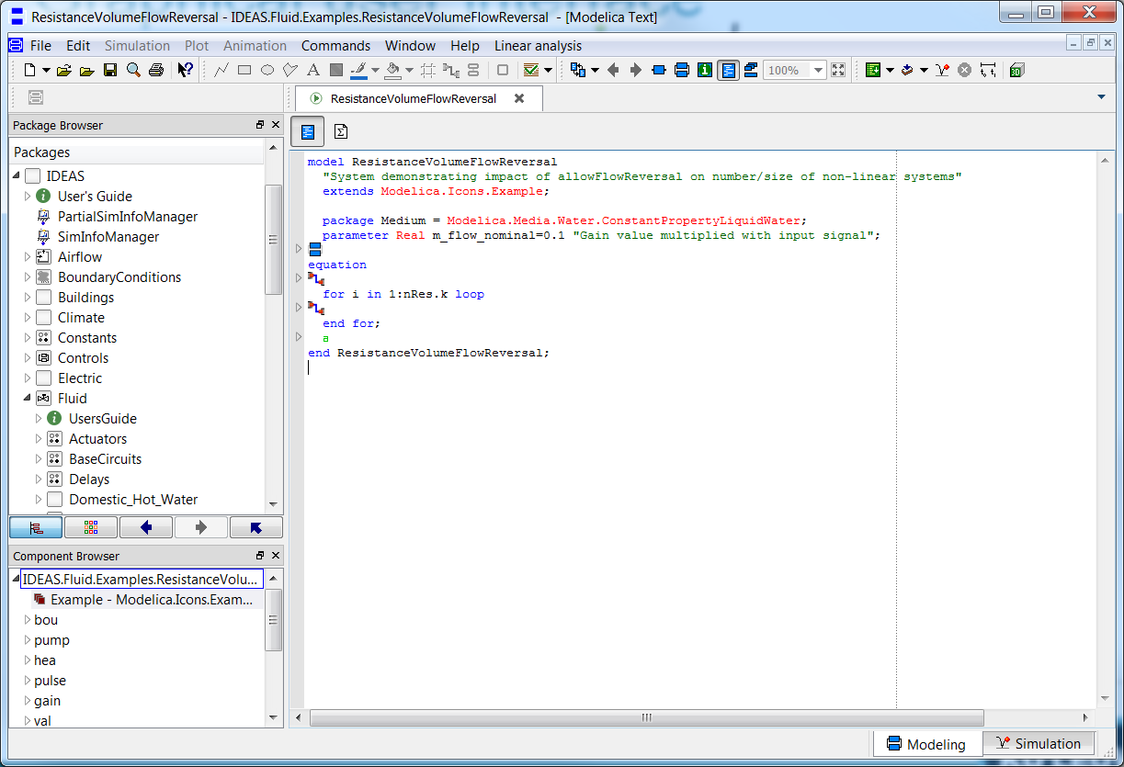
Graphical user interface
Modelica Text view
Notes:
icon toevoegen

Slide 19
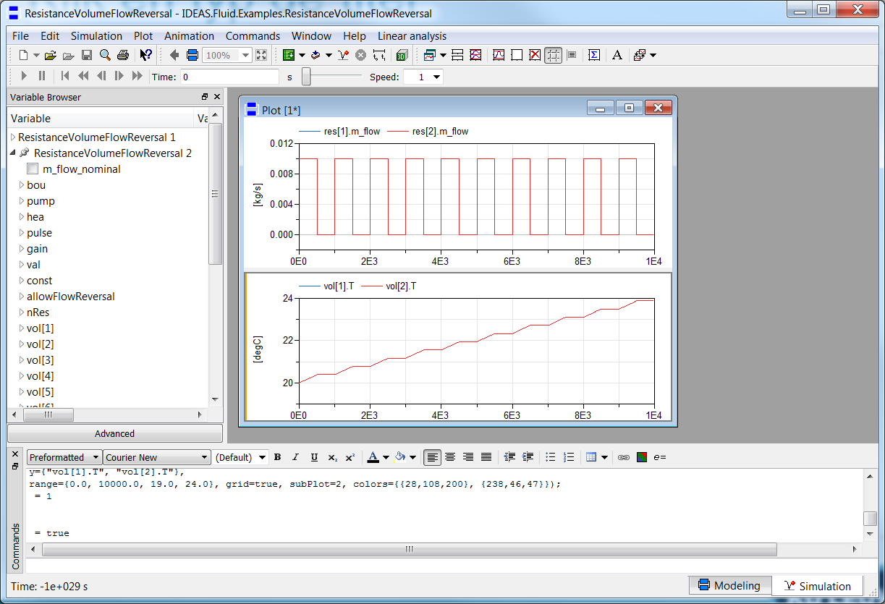
Graphical user interface
Simulation tab

Slide 20
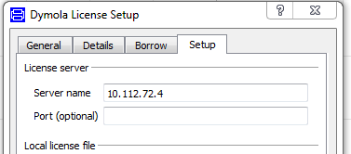
Use of Dymola with KULeuven license
Access to a floating license (on the building physics server).
Connect to WiFi
Open Dymola and go to Help > License…
Enter 10.112.72.4 and follow instructions

Slide 21
Modelica syntax and concepts

Slide 22
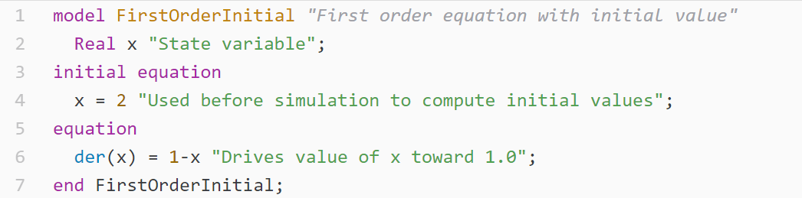
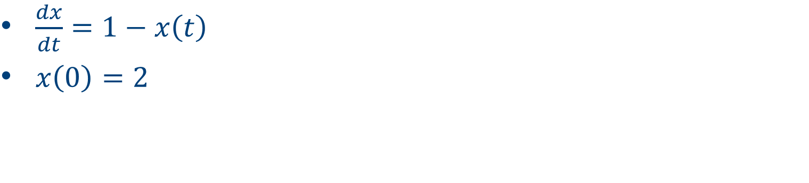
Your first model
$\frac{dx}{dt}=1−x\left(t\right)$
$x\left(0\right)=2$
Notes:
Define variable, define equation, define initial state

Slide 23
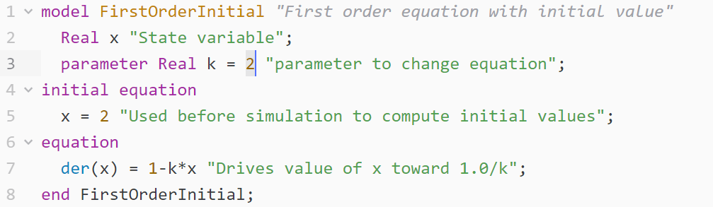
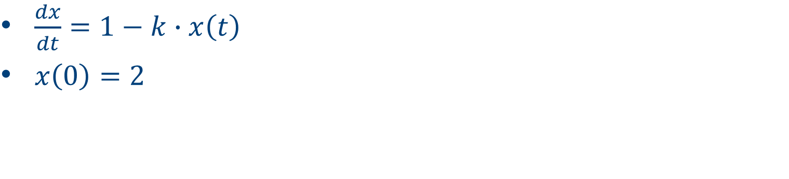
Your second model
$\frac{dx}{dt}=1−k∙x\left(t\right)$
$x\left(0\right)=2$
Notes:
Possible to define parameters: variables of which the value is known before, but can be changed by the user
Constants are used for parameters that are not likely to change

Slide 24
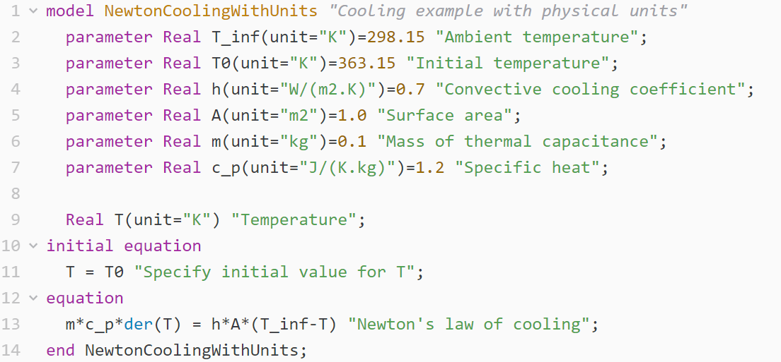
Assigning units

Slide 25
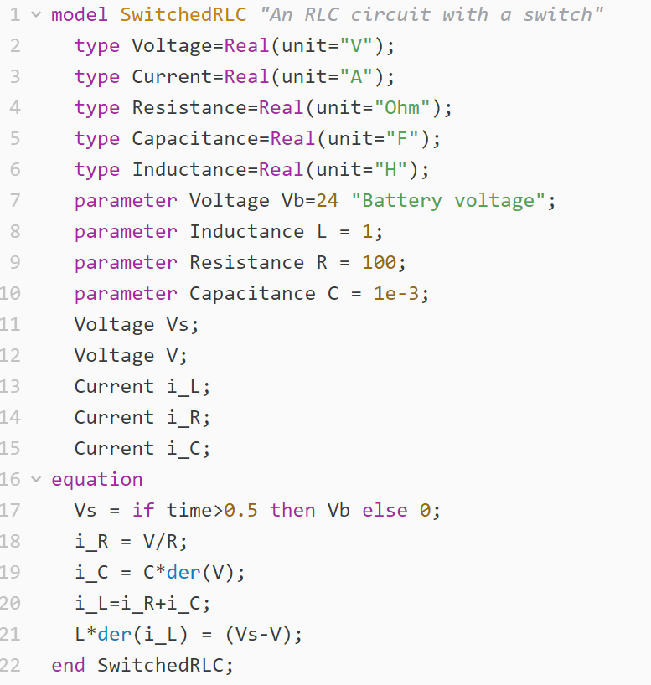
Physical types
Define own types
Use predefined SI units
e.g. Modelica.SIunits.Voltage

Slide 26
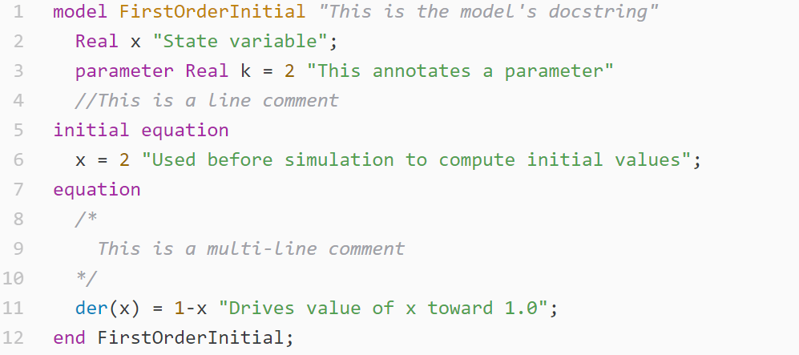
Documentation
Provide info to make code readable!
Notes:
types: assign unit to for example real, Boolean,…

Slide 27
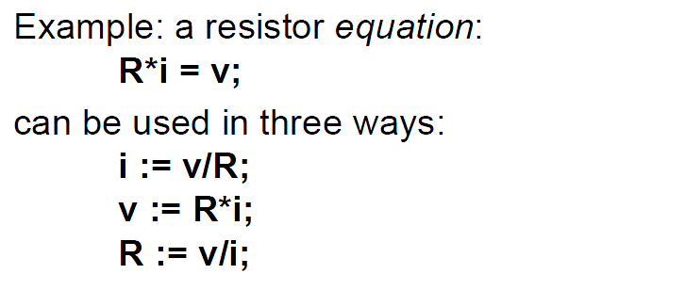
Equations
Arithmetic operators
* / + - ^ (use . for element-wise)
Time derivatives
der(x) = x ~
PDEs only after discretization or using specialized functions
Acausality
Slide from Peter Fritzson, Introduction to Object-Oriented Modeling, Simulation and Control with Modelica, Tutorial for Modelica Conference 2011, Dresden
Notes:
Modelica is a programming language. Overview of the most important parts of the syntax

Slide 28
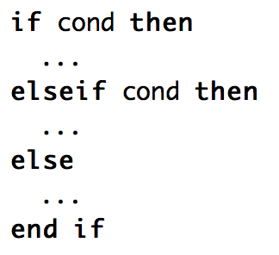

Logical operators, control flow
Logical
and or not … (see modelica specification for more)
Conditional
if elseif else
Loops
for
Comparing numbers
> < <> >= …
Check syntax!

Slide 29
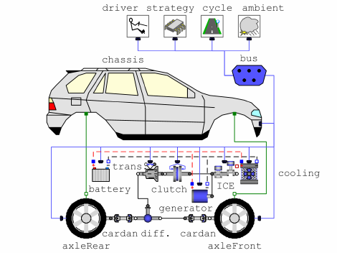
Let’s connect
Make two or more models interact
Electrical circuit
Building
Car
…
Need connectors
Source DOI: 10.4271/2007-01-0541, Simic et al.

Slide 30
Connectors
Usually
Signal in out
Fluid flow (mass flow rate, pressure, enthalpy)
Heat flow (heat flow rate, temperature)
Refer to one or more types
Allow only connections between equal connectors
Notes:
Types uitleggen => enkel juiste connecties maken

Slide 31
Connectors
Three examples:
Variables with and without “flow”
Flow variables
Potential variables
Stream variables
Fluid flow
Pressure
Mass flow
Specific enthalpy flow
Heat transfer
Temperature
Heat flow
Electricity
Voltage
Current
Slide from Peter Fritzson, Introduction to Object-Oriented Modeling, Simulation and Control with Modelica, Tutorial for Modelica Conference 2011, Dresden
Notes:
eerst flow uitleggen

Slide 32
Inheritance
Model inherits from other model
Variables, parameters, equations
partial model (➔ extends)
Code can be managed more easily
Example

Slide 33
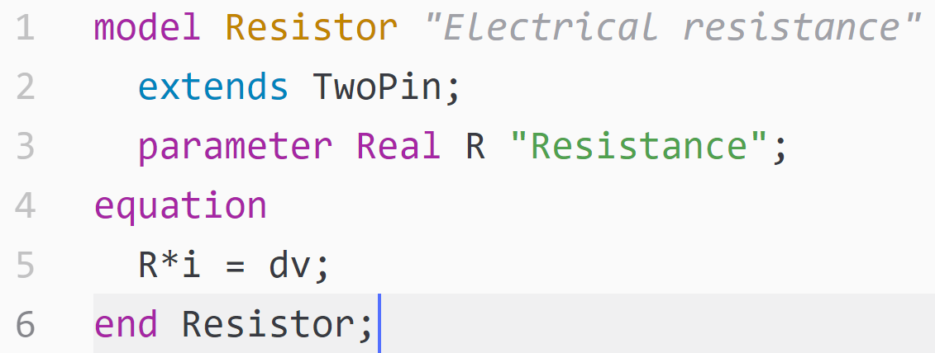
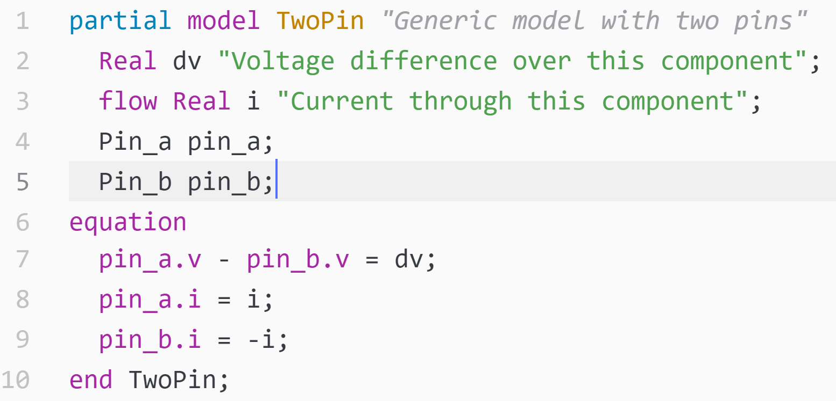


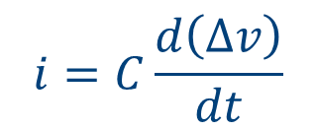
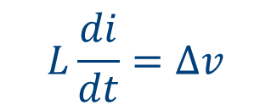
Inheritance
Resistance
extends TwoPin
$$Ri=∆v$$
Partial
TwoPin
Capacitance
extends TwoPin
$$i, ∆v$$
$$i=C\frac{d\left(∆v\right)}{dt}$$
Inductance
extends TwoPin
$$L\frac{di}{dt}=∆v$$
Notes:
Ander voorbeeld zoeken?

Slide 34
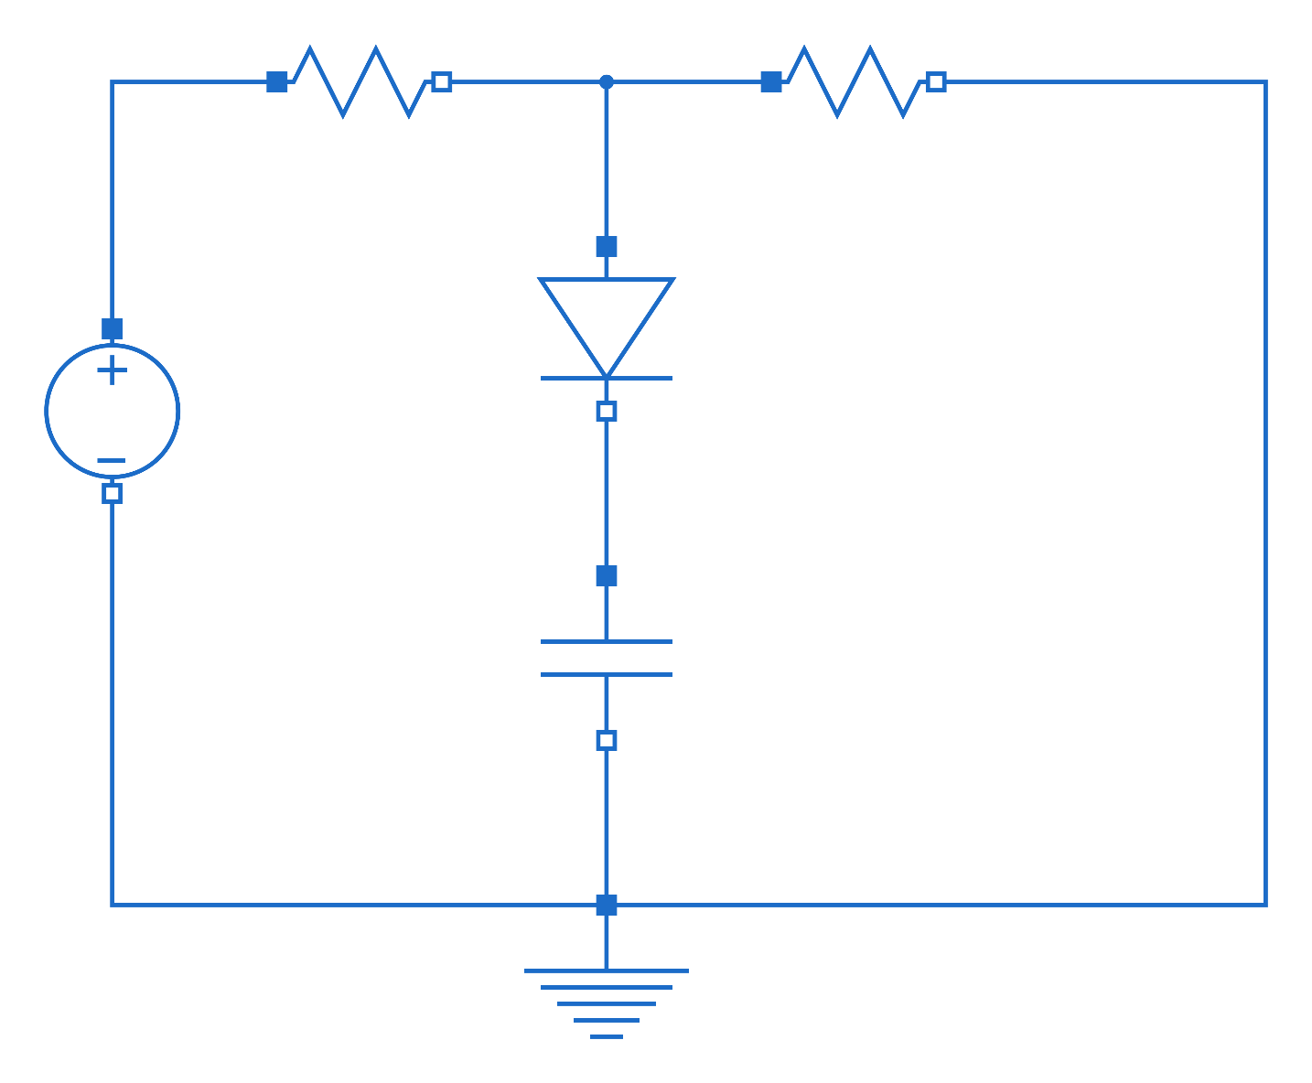
Homework exercise

Slide 35
Websites
General
www.modelica.org
www.openmodelica.org
www.jmodelica.org
http://www.claytex.com/tech-blog/
Modelica language
http://modref.xogeny.com/
http://book.xogeny.com/ !!!
Libraries:
https://github.com/open-ideas --> IDEAS + Crash Course
https://simulationresearch.lbl.gov/modelica --> look at Buildings.Examples.Tutorial
IBPSA Project 1: https://github.com/ibpsa/modelica-ibpsa
Dymola user guide
Volume 1 & 2: C:\Program Files (x86)\Dymola 2017\Documentation\Dymola User Manual Volume 1 or via Dymola > help.

Slide 36
Forums
http://www.openmodelica.org/index.php/forum
http://www.jmodelica.org/forum
www.stackoverflow.com (tag Modelica)

Slide 37
Modelica concepts

Slide 38
Modelica concepts
Busses and expandable connectors
inner/outer
Media
replaceable / redeclare
records

Slide 39
Busses and expandable connectors
Bus
Consists of other connectors/variables
Explicitly declared

Slide 40
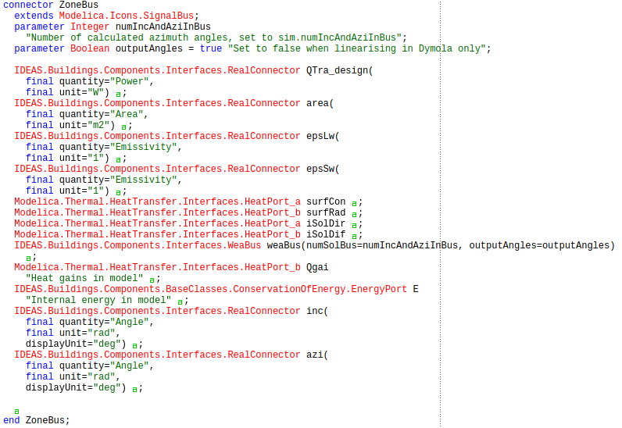

Slide 41
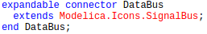
Busses and expandable connectors
Expandable connector:
Structure/elements derived from connections
Consistency checked at translation

Slide 42
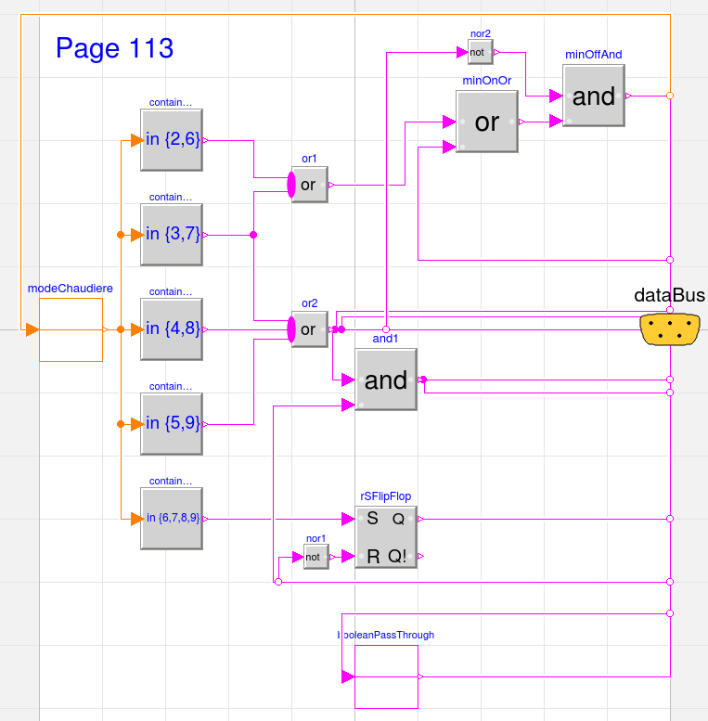

Slide 43
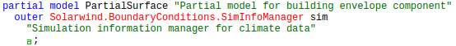
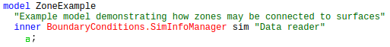
Inner/outer components
“outer” model → reference to model at higher level
“inner” model → top level instantiation of model
Example: SimInfoManager
only one weather data reader for all components
…
…

Slide 44
Media
Package that contains fluid properties
Various degrees of detail possible:
Moist/dry air
Pure water / glycol
Refrigerants
Various implementations possible:
First-principle equations
Tables
Polynomials
Default Media available
Needs to be specified (consistently) for each fluid component

Slide 45
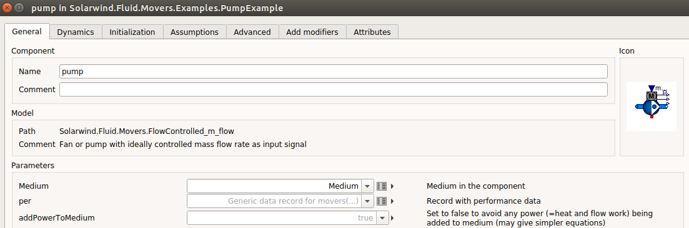
Media

Slide 46
Replaceable / redeclare
“redeclare” allows to replace a submodel in a model
i.e. similar to a parameter, which allows to replace a numerical value in a model
Allows the creation of templates, quick and convenient prototyping
Interface (e.g. connectors and parameters) must be consistent → “constrainedby”
Example: building template with multiple heating systems

Slide 47
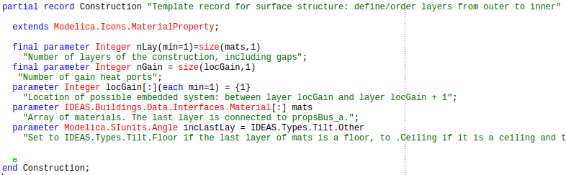
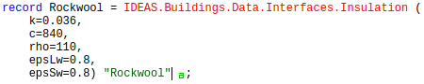
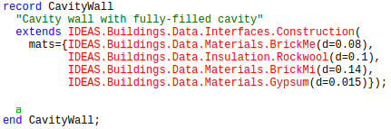
Records
Structured collection of parameters

Slide 48
Modelica libraries

Slide 49
Modelica libraries
Modelica components can be complex
E.g. a decent pump model can contain a few thousand lines of code, spread over multiple hierarchical levels (using “extends”)
Modelica users vs modelica developers
This complexity should not be exposed to users directly
=> Modelica libraries

Slide 50
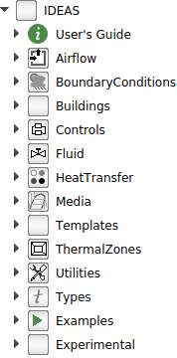
Modelica libraries
Hierarchy:
Modelica models can contain or extend other models
Modelica models can be grouped in packages
Modelica packages can be nested
A group of nested packages is a library
For building applications:
MSL
IDEAS
Buildings
See also IBPSA project 1

Slide 51
Modelica libraries
Goal of a library:
Provide a consistent collection of models
for a specific (research) domain
that is easy to use
and allows robust simulations
Consistent: conventions
research domain: e.g. level of detail depends on application
easy to use: intuitive parameters, connections, granularity
robust: equations, no division by zero when zero flow…
Documentation, examples, validations

Slide 52
Library example: IDEAS
Scope:
Building and district level energy simulations, including electrical distribution grids, district heating, HVAC and control

Slide 53
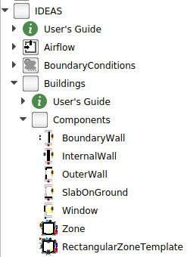
Library example: IDEAS
Buildings package:
Elementary models for composing building zones
Template

Slide 54
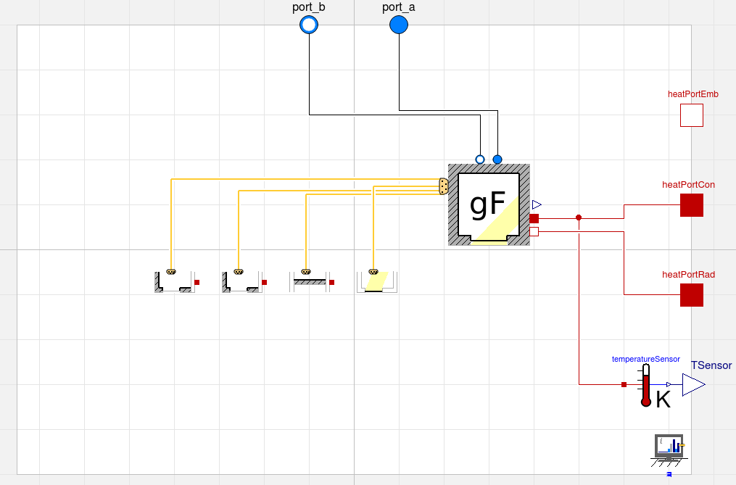
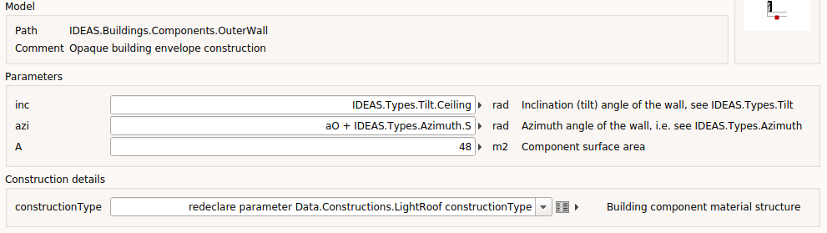
Library example: IDEAS

Slide 55
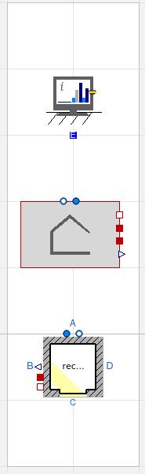
Library example: IDEAS
IDEAS.Buildings.Validation.Tests.ZoneTemplateVerification
Validation example
Unittested
Example of granularity

Slide 56
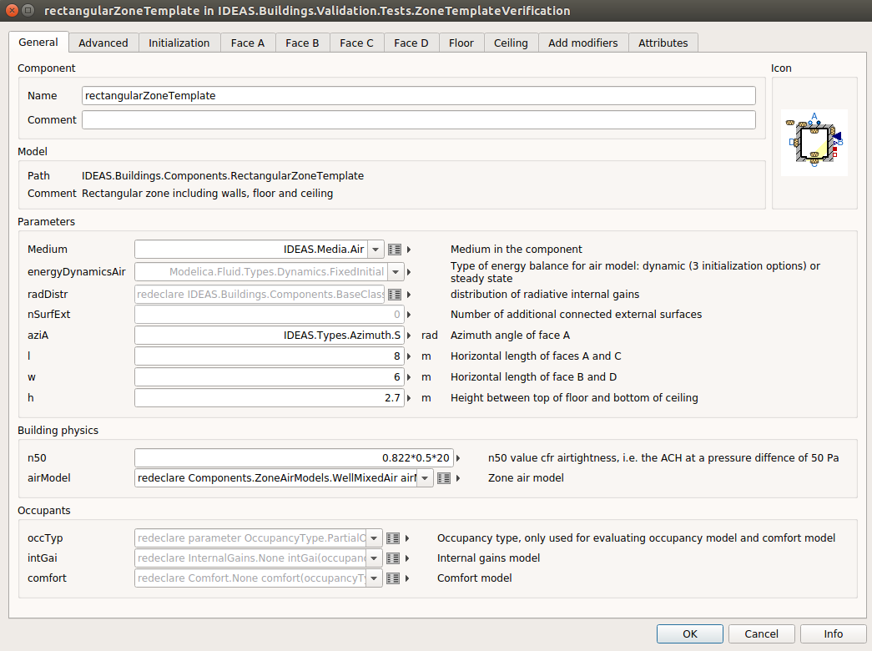
Library example: IDEAS

Slide 57
Library example: IDEAS
Availability:
Github: https://github.com/open-ideas/IDEAS
Use master branch
Issue tracker: bug reports
Documentation and examples: part of library

Slide 58
Exercise
SimpleHouse
Use template on GitHub: https://github.com/open-ideas/__CrashCourse__/blob/master/2017-2018/Exercises/SimpleHouse/SimpleHouseTemplate.mo

Slide 59
IDEAS building models
Examples

Slide 60
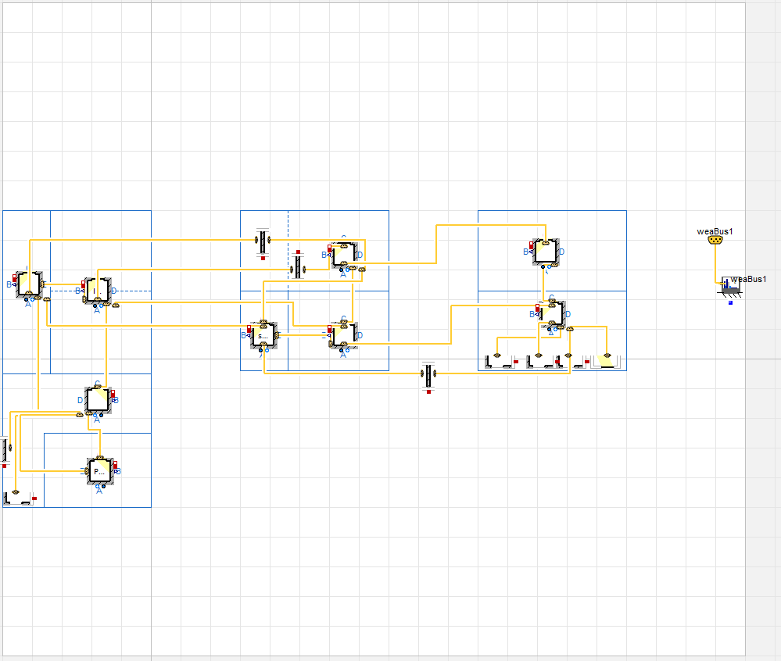
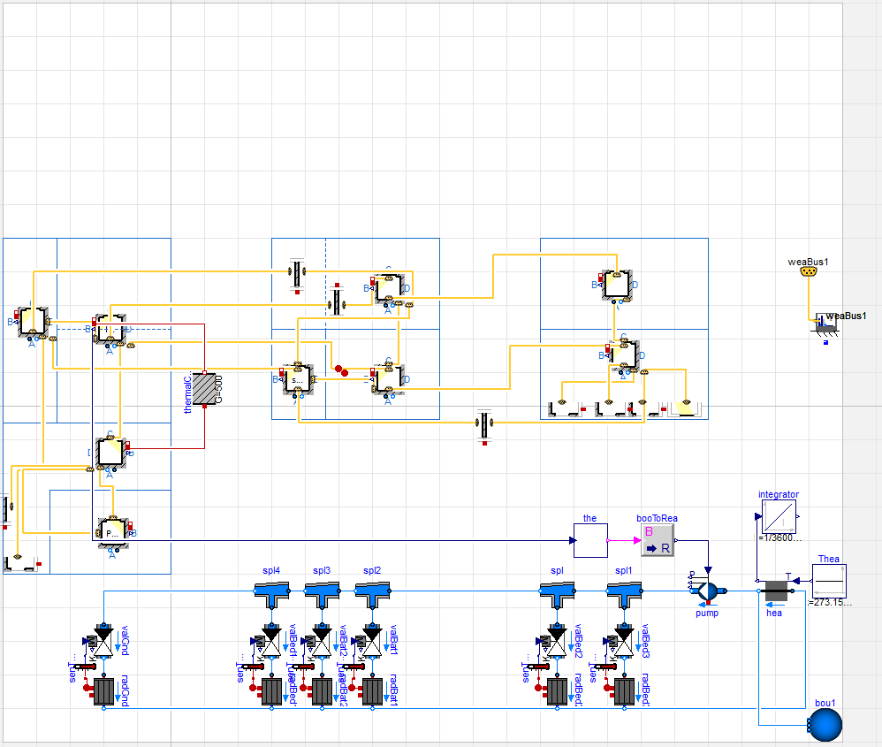
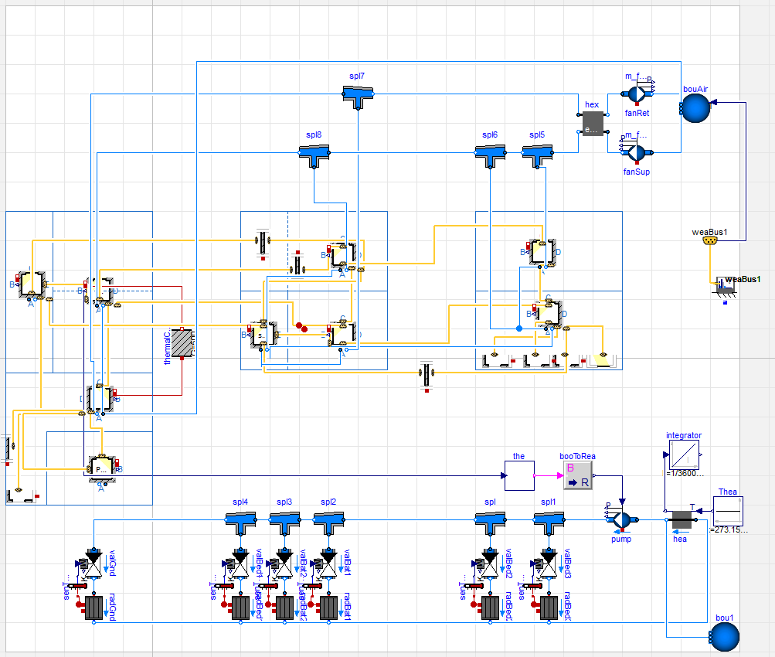
Single model
All building components are included in one model
Better overview
Appropriate for simulation of specific building
For less cluttered models: IDEAS.Buildings. Components. RectangularZoneTemplate
Example: IDEAS.Examples.PPD12

Slide 61
Templates and interfaces
Building
Climate
Ventilation system
Structure
Heating system
Electric
in-home grid
Electricity grid
Occupants
District heating network

Slide 62
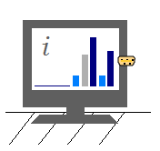
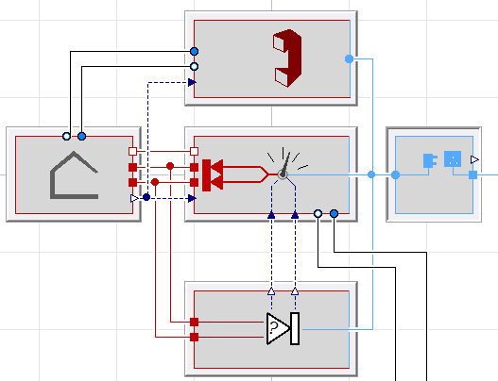
Templates and interfaces
IDEAS.Templates.Interfaces.Building
Electricity grid
District heating network

Slide 63
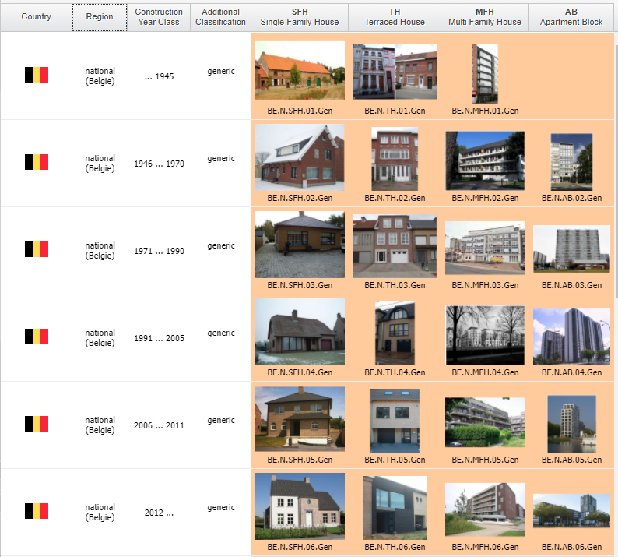
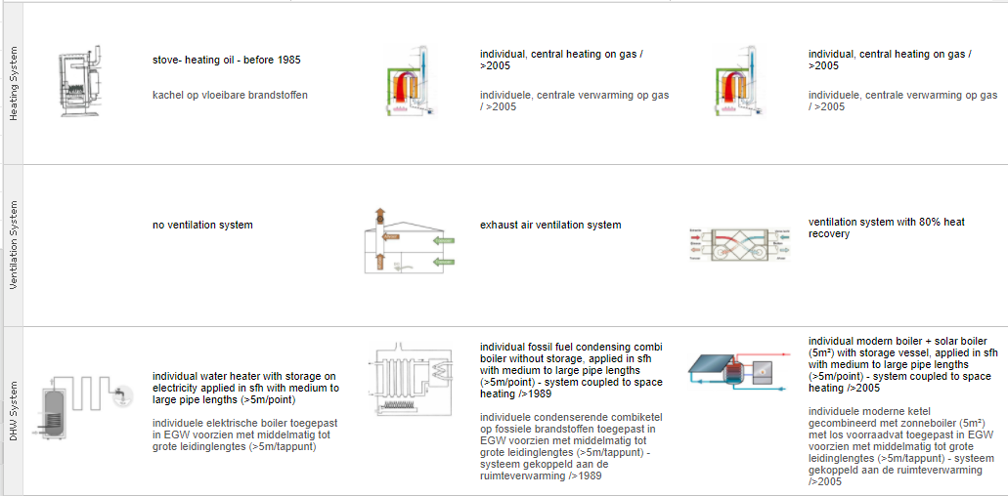
Templates and interfaces
For integration in district simulations
When different sub-components need to be used
Comparison of HVAC systems for a building
Archetype buildings
Examples: IDEAS.Templates.Interfaces.Examples.building
IDEAS.Buildings.Validation (BESTEST)

Slide 64
Parameterized building model
For uncertainty analyses, design optimization, sensitivity analysis…
Run multiple simulations with different parameters or different components
After translation set non-evaluated parameters
Change components by creating new models
Run all cases using scripts (*.mos files)

Slide 65
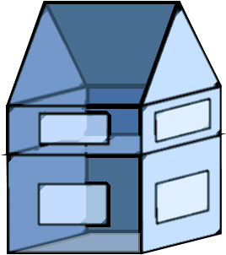
Parameterized generic building model
For probabilistic building stock models
For buildings generated based on GIS data
Generic building structure
Defined by few parameters and many assumptions
Run all cases using scripts (*.mos files)

Slide 66

Script.mos
MyFolder="C:/Users/MyProject";
BuildingTypes={"D", "T"};
openModel(MyFolder + "/MyBuildings/package.mo");
cd(MyFolder + "/Results")
for bt in BuildingTypes loop;
translateModel ("MyBuildings." + bt);
for i in 1:100 loop;
caseName= "case_" + bt + "_" + String(i);
RunScript(MyFolder + "/Scripts_for_changing_parameters/" + caseName + ".mos");
component1.parameter1=3*i;
simulateModel("MyBuildings." + bt, stopTime=3.1536e+007, numberOfIntervals=0, outputInterval=600, method="Radau", tolerance=1e-006, resultFile= caseName);
end for;
end for;
see also: Dymola User Manual Volume 1, 5.5.19 Built-in functions in Dymola, p.633
http://www.claytex.com/blog/how-to-simulate-a-model-multiple-times-with-different-parameter-values/

Slide 67
Demonstration in Dymola
Building components and materials
Zone models
Building structures
Whole building interfaces
See examples:
IDEAS.Examples.PPD12
IDEAS.Templates.Interfaces.Examples.building

Slide 68
Advanced concepts
Compact overview

Slide 69
Advanced concepts
Classical tools:
domain-specific => optimised algorithms
same people develop models and solvers
Modelica:
general purpose solvers
libraries often designed for robustness, not speed
computation time is solver and problem-dependent
To obtain fast implementations of large models it helps to know:
the basic algorithms of the Modelica translation tool chain, and
relevant library design decisions!

Slide 70
Advanced concepts
Modelica code translated into efficient and portable C code
i.e. not interpreted at runtime like Python, Matlab, …
Typical Modelica tool chain steps:
Parsing (read models in code)
Flattening (expand model object equations)
Tarjan’s algorithm (sort equations)
Code generation (write C code)
Compilation (compile C code)
Initialization (solve initial equations)
Simulation (continuous time integration)

Slide 71
Advanced concepts
Tarjan’s algorithm
Sorts equations in an order such that the can be solved sequentially, and
identifies the smallest sets of equations that need to be solved simultaneously:
linear algebraic loops
non-linear algebraic loops
…
=> Determines what equations are solved for what variables (remember: acausal modelling)

Slide 72
Advanced concepts
Algebraic loops (coupled systems of equations):
solved using Newton solver (requires many iterations)
can be decoupled by introducing states
but: introduces more overhead for time integrator
other ‘tricks’ possible

Slide 73
Advanced concepts
Time integrator
explicit
Unstable for large time steps
Examples: Euler, Runge Kutta, Dopri
implicit
Requires iterations (expensive)
Scales badly for large problems
Examples: Dassl, LSodar, Radau
Fixed vs variable time step

Slide 74
Advanced concepts
Further information:
Jorissen, F., Wetter, M., & Helsen, L. (2015). Simulation Speed Analysis and Improvements of Modelica Models for Building Energy Simulation. In P. Fritzson & H. Elmqvist (Eds.), 11th International Modelica Conference (pp. 59–69). Paris: Modelica Association. http://doi.org/10.3384/ecp1511859

Slide 75
Advanced applications
Optimal control
Scripting from command line
Parameter variation
Parallel simulations
Python post-processing
Nice for plotting
BuildingsPy (http://simulationresearch.lbl.gov/modelica/buildingspy/)
Built-in interface
MATLAB interface
Built-in with Dymola
External C functions

Slide 76
Components
Instances of a model
model name usually Capitalized, instance not
Wall innerWall(res = 200, A = 10);
public variables and parameters can be accessed with dot notation, e.g.:
heatPort.Qflow
wall.res
Protected variables/params cannot be accessed
Don’t show up in simulation results
Notes:
Naar deel libraries? ➔ Filip

